Slide 1
PATBMS – Phase 2
Refined Design and Implementation
Patient Admission, Triage and Bed Management System
Waitakere Hospital – Te Whatu Ora Health New Zealand
Mohammed Yaacoub Abou Chlih
21138726
ENSE706 – Data Process and Software Modelling
31 May 2026

Slide 2
What phase 2 addressed
Phase 1 identified four design weaknesses:
No interfaces – tight coupling between classes
Role stored as string – no validation
Separation of responsibilities – UpdateBedStatus in wrong classes
No access control mechanism in class structure
Phase 2 solution
Applied four GoF design patterns
Refined UML models with interfaces
Built fully functional ASP.NET Core web application
SQLite database with real patient and bed data

Slide 3
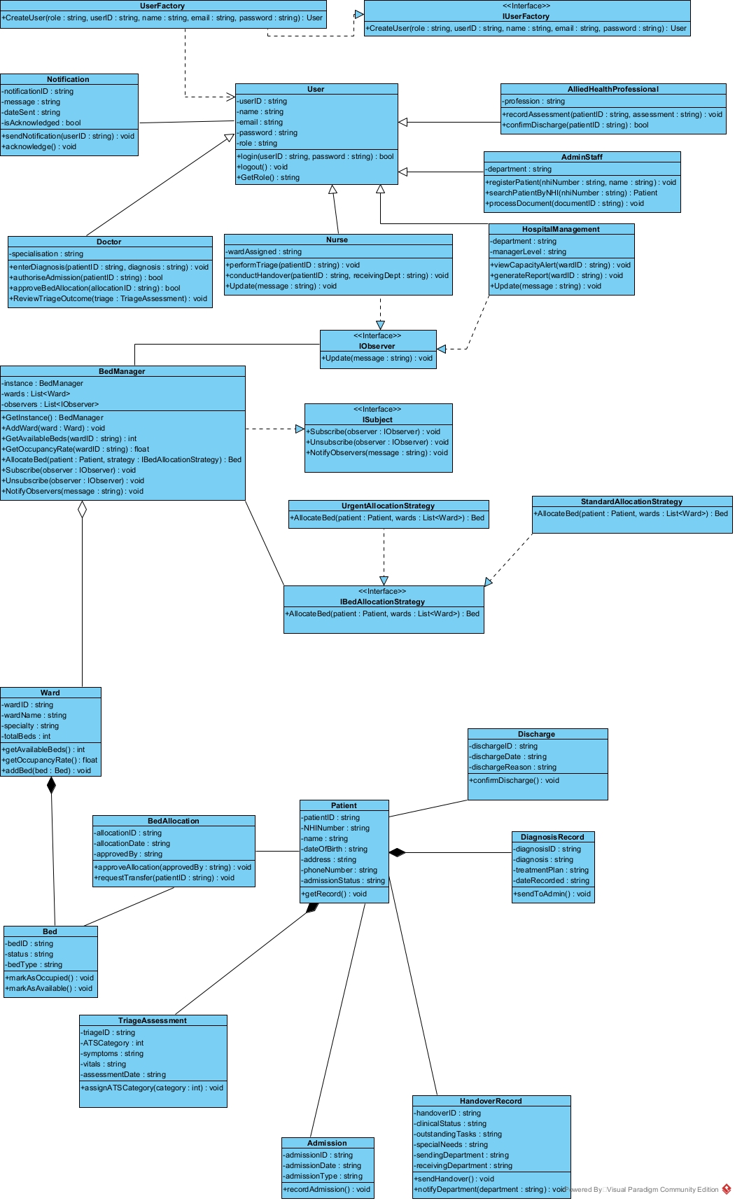
Refined Class Diagram
Key Changes from Phase 1:
4 new interfaces added – IObserver, Isubject, IBedAllocationStrategy, IUserFactory
4 new classes – BedManager, UserFactory, UrgentAllocationStrategy, StandardAllocationStrategy
UpdateBedStatus removed from Discharge and Nurse
Moved to BedManager – single responsibility
16 classes → 20 classes and 4 interfaces

Slide 4
Four GoF Patterns Applied
Creational:
Factory – UserFactory creates correct User subclass based on role, removing direct instantiation
Singleton – BedManager single instance manages all bed state across all controllers
Behavioural:
Observer – BedManager notifies Nurse and HospitalManagement automatically when occupancy changes, implementing FR12 and NFR6
Strategy – Bed allocation logic selects ward based on ATS category, implementing FR9

Slide 5
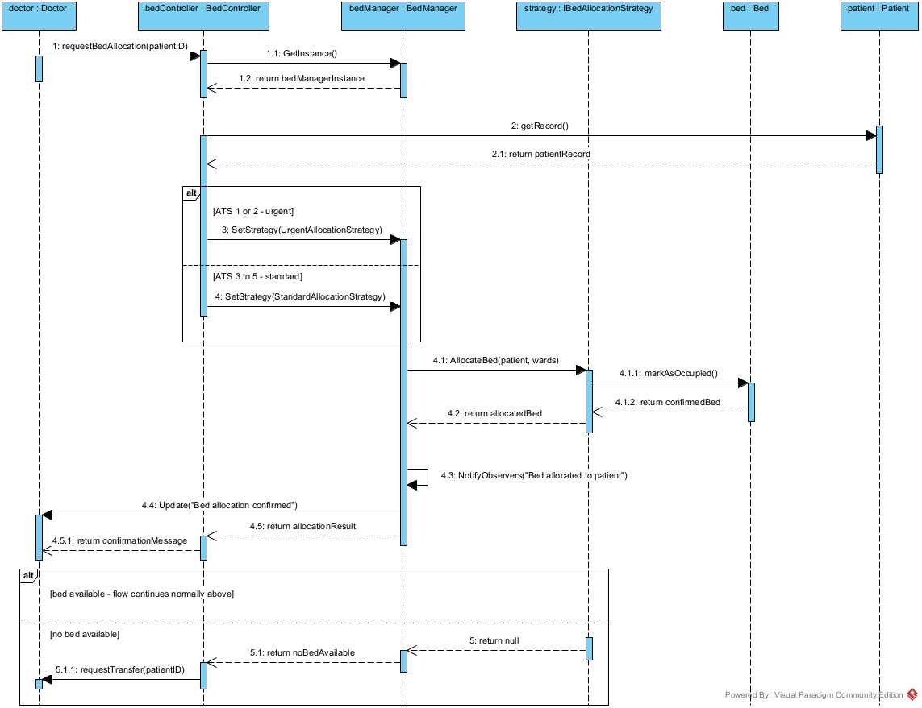
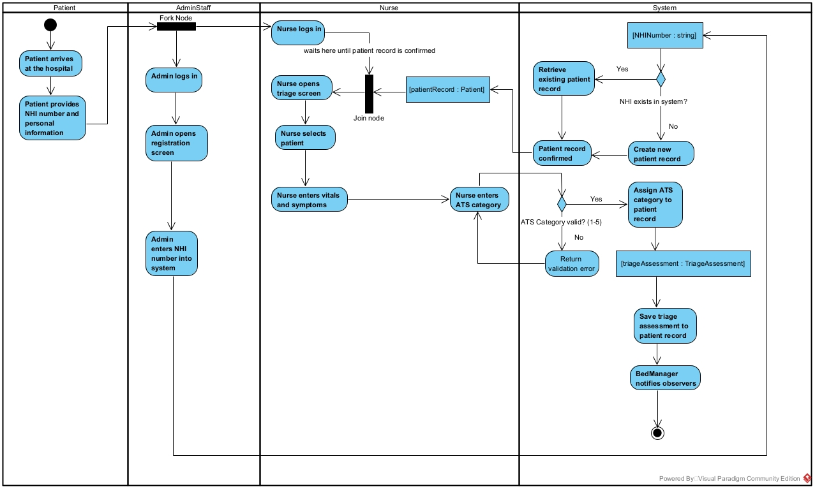
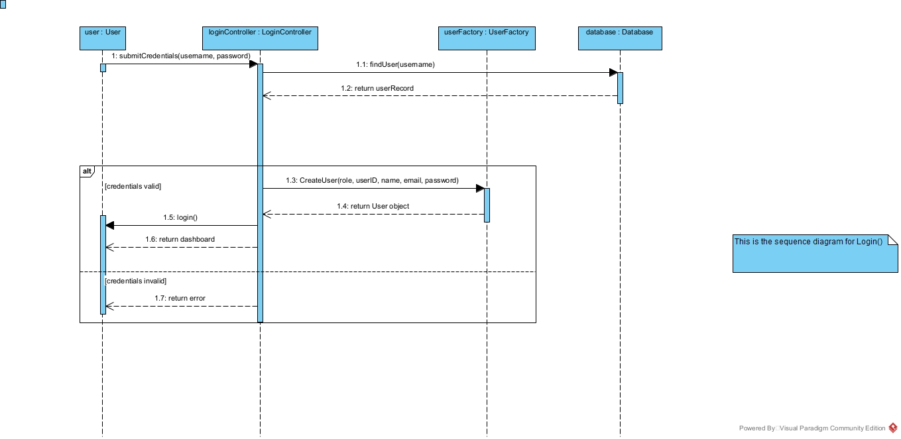
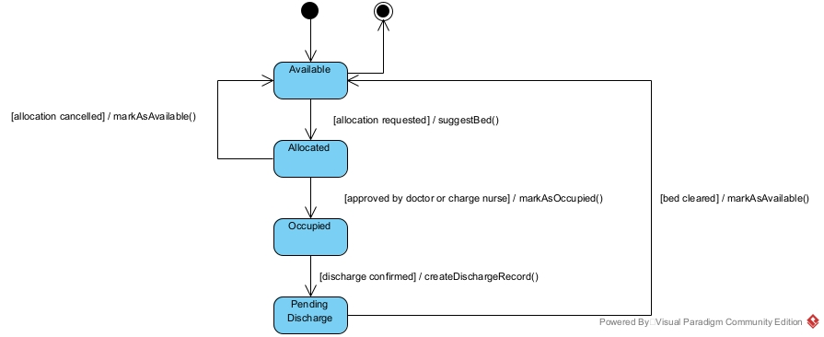
Activity Diagram:
Patient Registration and Triage – 4 swim lanes, fork node, join node, object nodes and ATS validation loop
Sequence Diagrams:
Login – Factory Pattern in authentication flow
Triage – Observer pattern notification after ATS (not visible)
Allocate Bed – Strategy pattern ward selection
State Machine:
- Bed Status – Available, Allocated, Occupied, Pending Discharge lifecycle

Slide 6
ASP.NET Core Web Application
Tech Stack:
ASP.NET Core MVC (.NET 9)
Entity Framework Core
SQLite database
Role based session authentication
Pages Built:
Login with role based dashboard redirect
Patient registration and NHI search
Triage with ATS category validation
Bed dashboard with colour coded ward grids
Bed allocation with ward-based strategy
Discharge with automatic bed status update
Inter-department handover
Notifications with acknowledge function
Diagnosis and treatment plan

Slide 7
Comparative Analysis
Aspect | Phase 1 | Phase 2
Classes | 16 | 20
Interfaces | 0 | 4
UpdateBedStatus | Discharge + Nurse | BedManager Only
User Creation | Direct | UserFactory
Notifications | Console.Write | Observer Pattern
Bed Allocation | None | Ward-based Strategy
Database | None | SQLite via EF Core
Interface | Console app | ASP.NET Core web app

Slide 8
Honest Reflection – Known Limitations
Implementation gaps:
Allocated and PendingDischarge bed states exist in UML – code implements Available and Occupied
Planned for Phase 3
Strategy selection logic in BedController rather than fully encapsulated in BedManager
Pragmatic deviation due to framework constraints
Plain text passwords – BCrypt hashing planned
SQLite locally – MySQL blocked off campus, migration ready for on campus deployment
BedManager Singleton outside ASP.NET Core DI
Acknowledged trade-off, xUnit refactor planned
Phase 3 Improvements:
Full bed state implementation
BCrypt authentication
BedManager in DI container
Formal foreign key relationships
Audit logging for NFR3

